Slide 1









RECYCLING REVOLUNTION APP
SaafPakistan
LETS PAINT PAKISTAN GREEN!
Ali Sher (F2020-158)
Nouman Ali (F2020-149)
Mian Faizan Munawer (F2020-148)

Slide 2
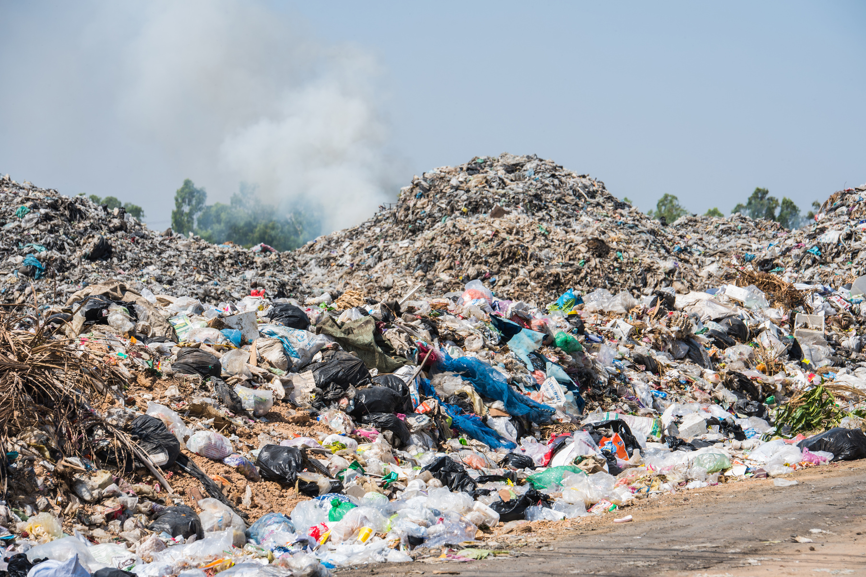
Problem
Pakistan's unstructured recycling system leads to disorganized waste disposal, causing environmental pollution and recyclable accumulation in landfills.
Lahore alone generates approximately 8,000 tons of waste daily, with only 27% of this waste being recycled.
[1]
Azam, M., et al. (2019). "Status, characterization, and potential utilization of municipal solid waste as a renewable energy source: Lahore case study in Pakistan."

Slide 3
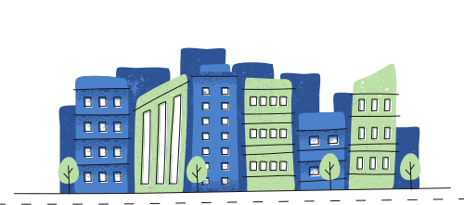
Solution Methodology
Researched on current recycling system in Lahore
We conducted surveys on people’s recycling habits.
Researched on existing solutions.
Got in contact with 2 organizations (Active Apparels, Three Star Hosiery) and learned about their recycling habits/structure.
Got in touch with the local scrap dealers.

Slide 4
Findings
Lahore Lacks a structured recycling system.
83% of the people wee surveyed did not recycle because the did not know any convenient means of recycling.
75% of the people said that they would start recycling if it were made convenient through an app.
No existing solutions similar to our app exist in Pakistan.
We found out that Organizations recycle tons of waste on monthly basis.
We also found out that the dealers who take this recyclable waste from the organizations have huge profit margins

Slide 5

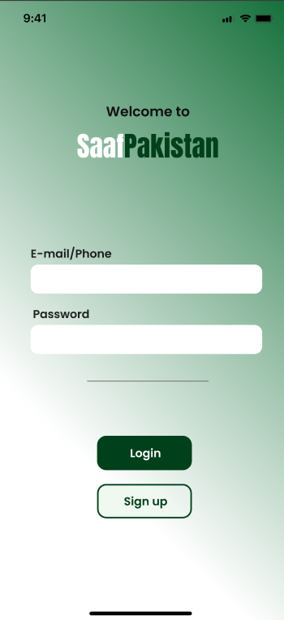
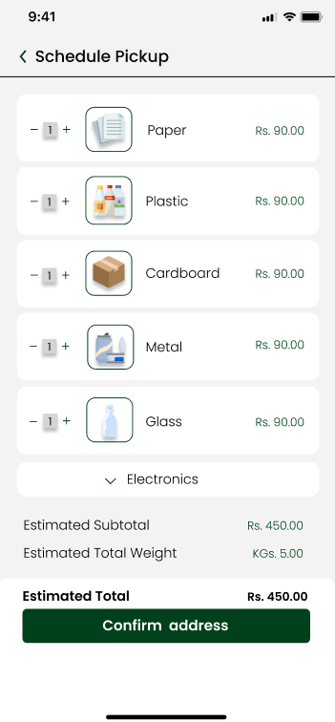
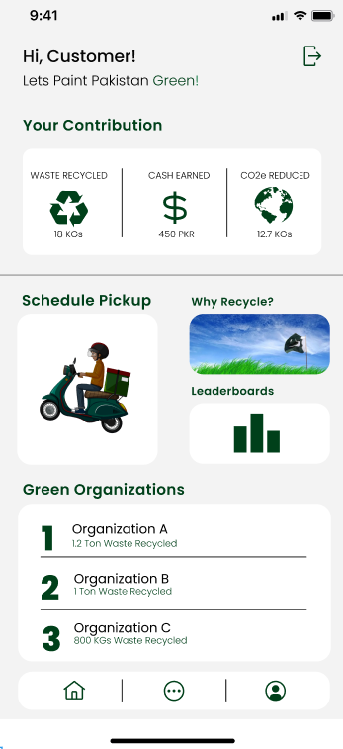
Solution
"Introducing SaafPakistan: Your App for a Cleaner, Greener Tomorrow!"

Slide 6
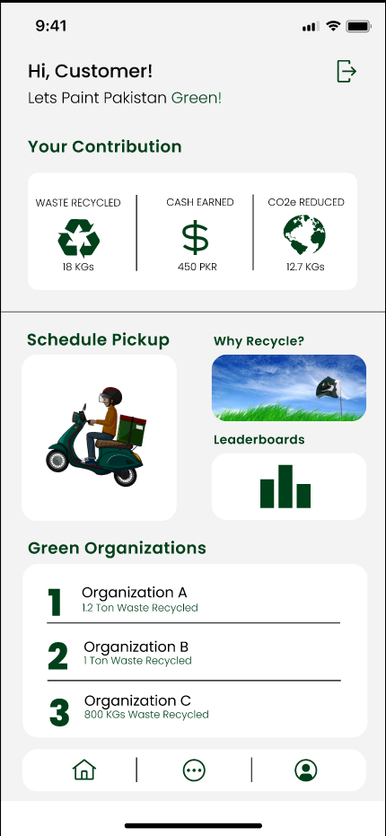
Features
Progress
Get updated of your real-time progress
Educational Content
Schedule Pickup for Recycling
Gamification
A dynamic leaderboard system for individuals and businesses, fostering a sense of competition.
Compete against friends
For Green Marketing

Slide 7
Technologies
Deliverables
Figma (Prototypes)
React (WebApp Front End)
Flutter ( Mobile App Front End)
Firebase (Back End/ Hosting)
GitHub (Code Sharing)
WebApp (Admin/Manager Dashboard)
Mobile App (Consumer/Rider)

Slide 8
High-Level Architecture
Admin
[Person]
Warehouse Manager
[Person]
Customer
[Person]
Rider
[Person]
SaafPakistan Admin, Managing riders and warehouse manager
saafPakistan Warehouse manager, Confirming riders delivery to warehouse
A customer of the Saafpakistan, Recycling through the app
A rider working for saafPakistan
register riders, register warehouse manager, and upload Material's rates payment proof using
view pending
and completed pickups,
confirm rider deliveries
using
Schedule Recycling pickups,
View Personal recylcing stats,
Compete with friends and others with leaderboards, view payments recieved
and their status using
view and complete
assigned pickups and
generate receipts using
Web Application
[Container: React]
Mobile Application
[Container: Flutter]
Provides Admin to manage
mobile app users and the system
and Warehouse manager to manage rider pickups via web app
Provides customer an app
for their recycling needs.
Provides rider the ability to
complete pickups via mobile
device
Database
[Container: Firebase Firestore]
Read from and writes to
Read from and writes to
Stores user information,
rider information,
Admin Information,
Recycling Materials Rates,
Leaderboard Rankings,
Recycling schedules
hashed authentication credentials, etc.
Software System

Slide 9
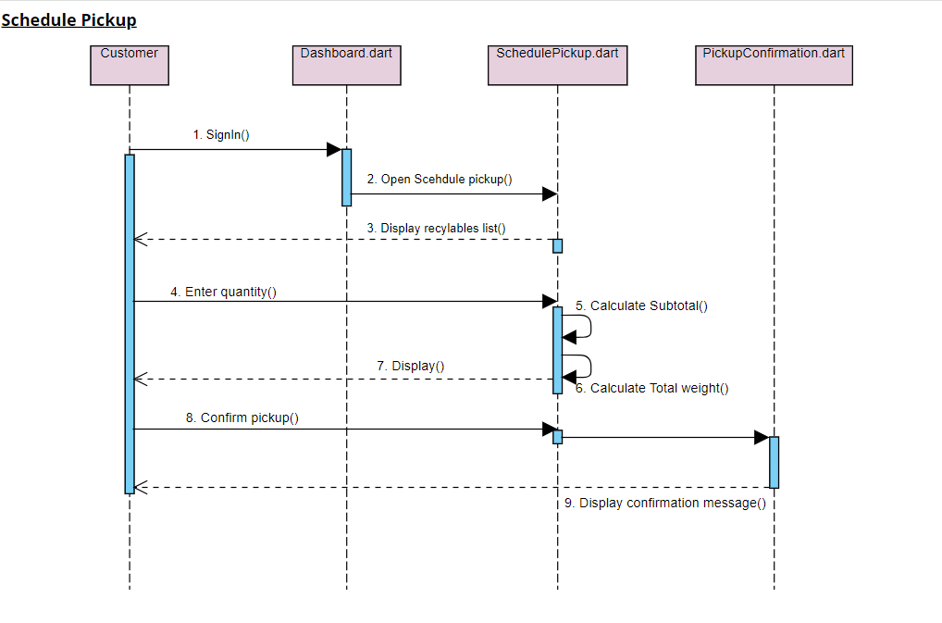
Schedule Pickup Sequence Diagram

Slide 10
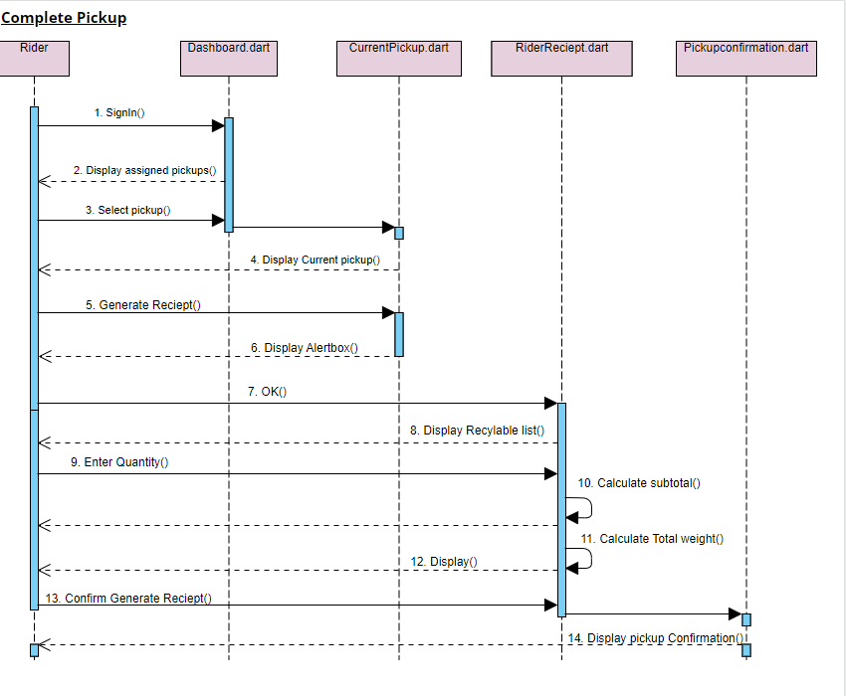
Complete Pickup Sequence Diagram

Slide 11
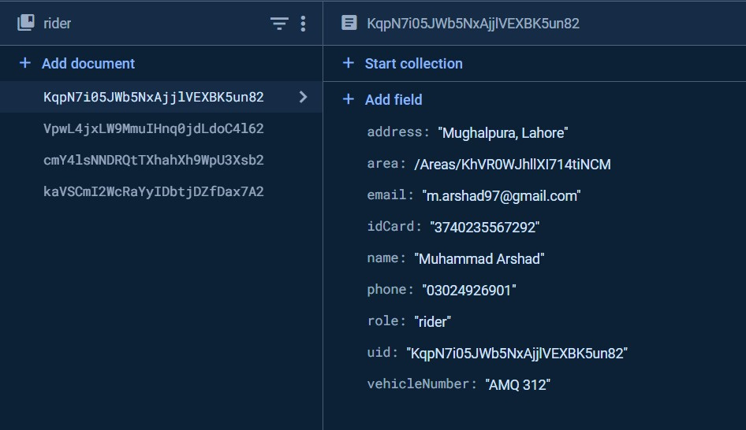
Project Database
Collection
Reference
Documents

Slide 12
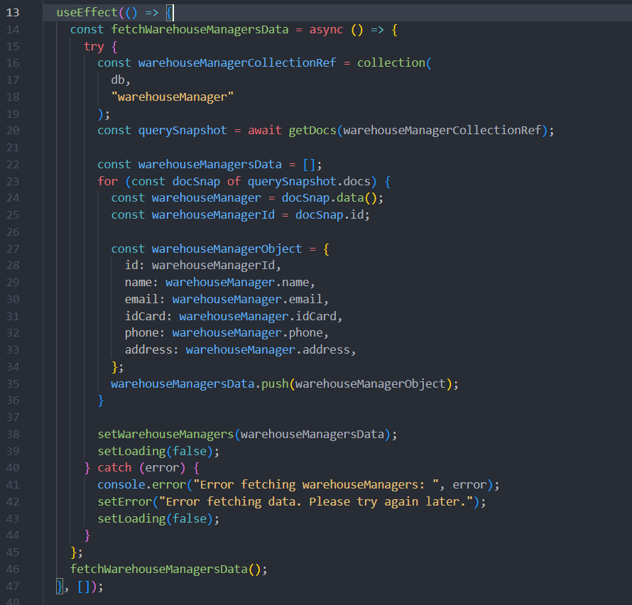
Code Snippet React App
Fetching Warehouse Managers Data

Slide 13
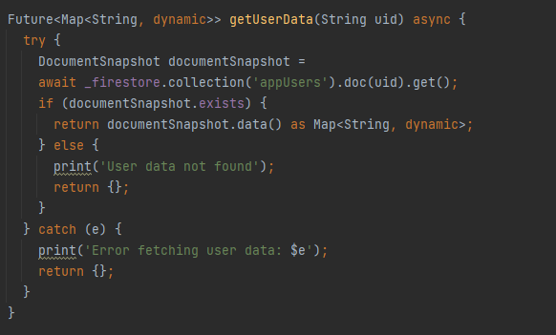
Code Snippet Flutter App
Getting User Data for Customer Login

Slide 14
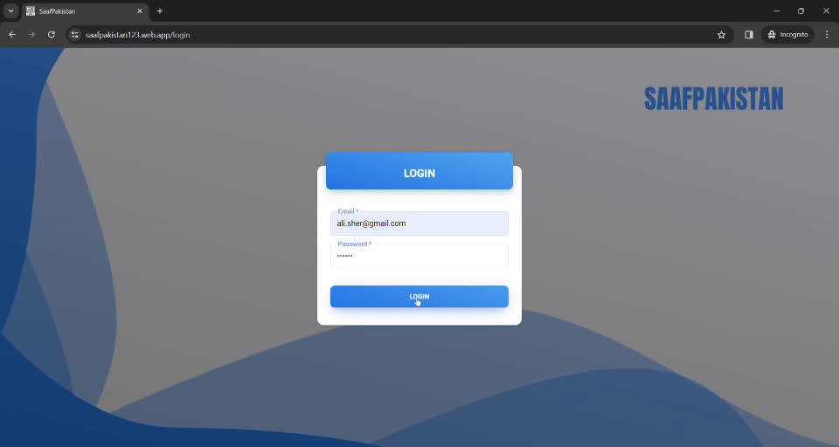
Web App Admin login

Slide 15
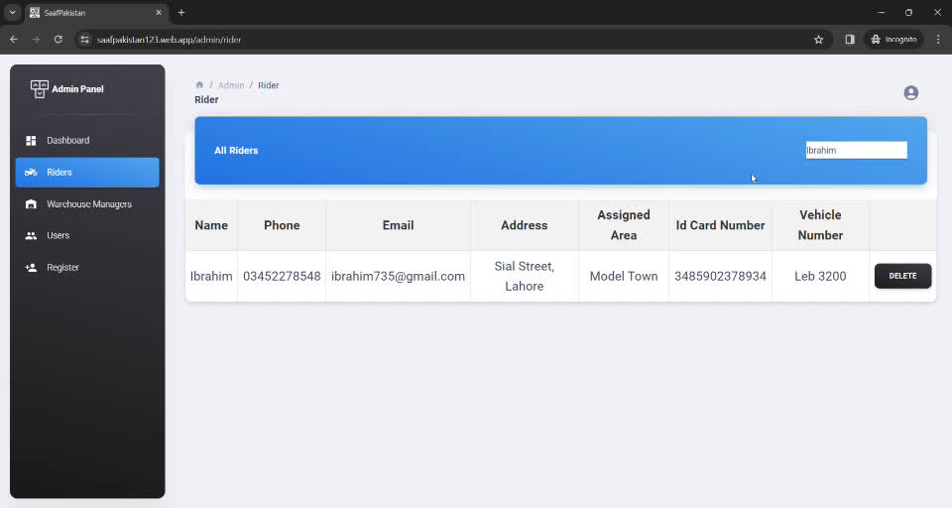
Web App View All User Details

Slide 16
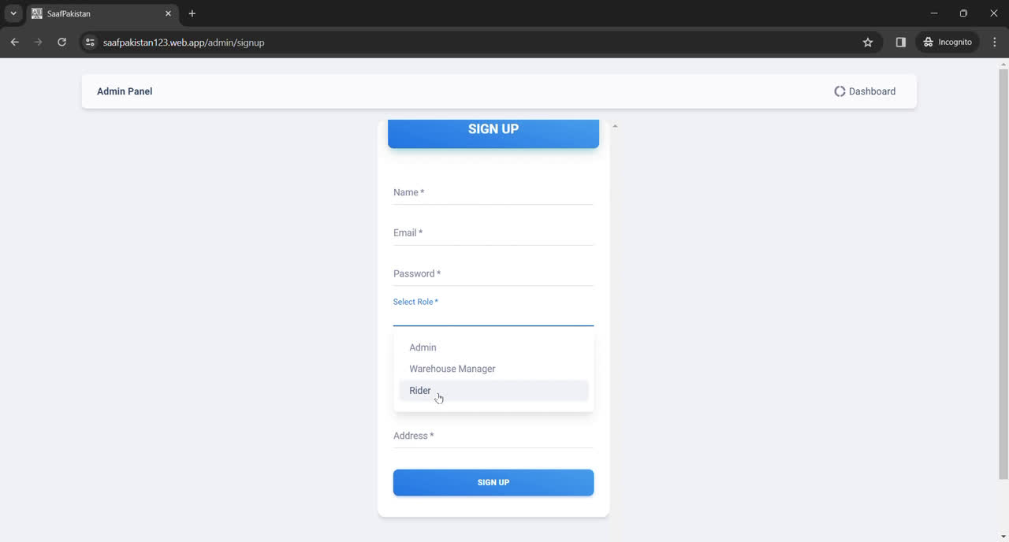
Web App Registration Form

Slide 17
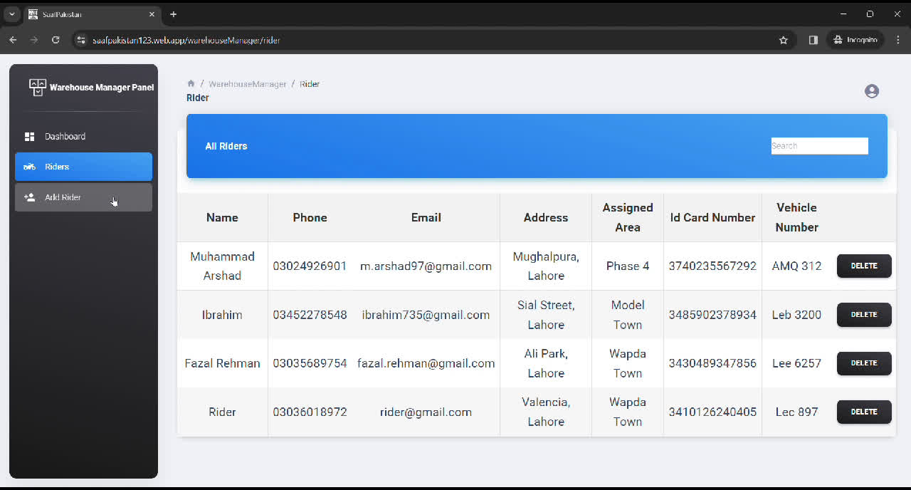
Web App Admin login

Slide 18
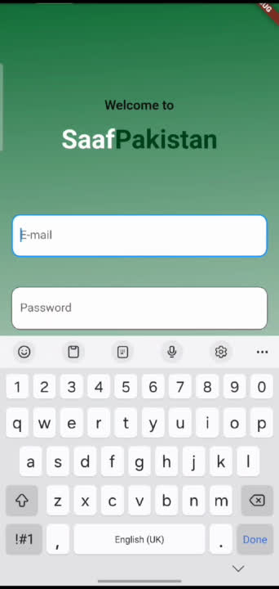
Mobile App Customer Login

Slide 19
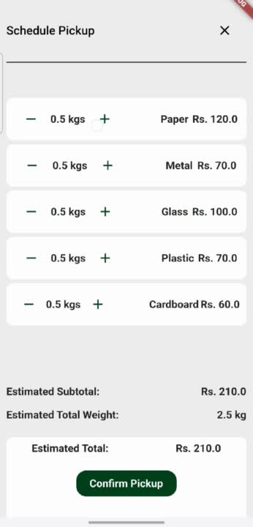
Mobile App Schedule Pickup

Slide 20
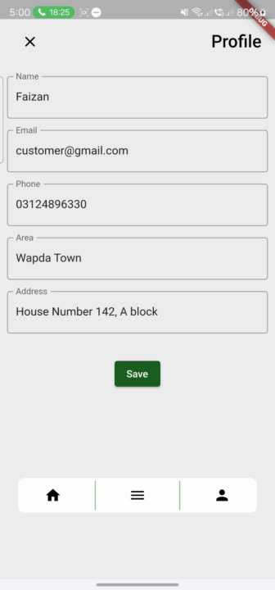
Mobile App Customer Profile and Why Recycle page

Slide 21
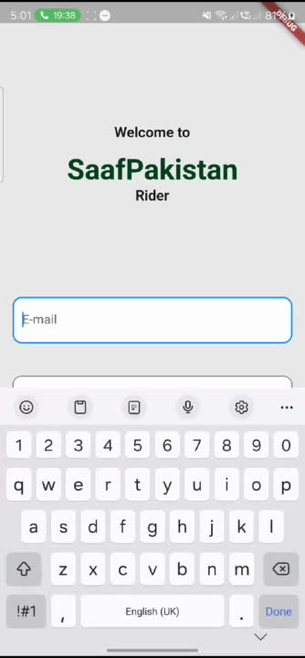
Mobile App Rider login & Profile

Slide 22
Key Issues
Finalizing Language for Mobile app development
Learning React from Scratch
Finalizing project database
Resolution
We opted for flutter as we were studying a course on it and knew that it would be helpful in our development.
Opted for online courses and google.
Finalized firebase as we were actively studying firebase operations in the semester course.

Slide 23
Future Plans Mobile App
Develop leaderboards component (Gamification)
Develop friends component (Gamification)
Optimize schedule pickup algorithm
Develop customer recycling Statistics display Backend
Develop order history component
Develop payment history and reward component
Develop receipt component for customer
Develop pickup component for rider
Develop receipt generation component for rider
Develop approval component for rider
Integrate TPL maps API for rider routes and customer address
Deploy mobile app on playstore

Slide 24
Future Plans Web App
Develop dashboard (stats)
Develop update feature for all components
Develop uploading payment proof
Develop view pending payments
Develop uploading tips and tricks
Develop create and updating recycling items and rates
Develop view pickups component ( pending, completed, cancelled)

Slide 25
References
https://www.sciencedirect.com/science/article/pii/S0160412019322986

